Slide 1
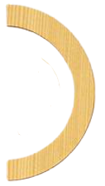
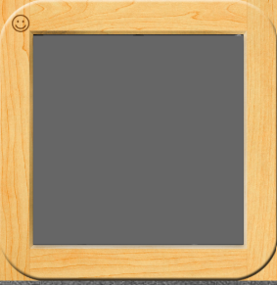
Handwriting Without Tears
Letter Practice

Slide 2
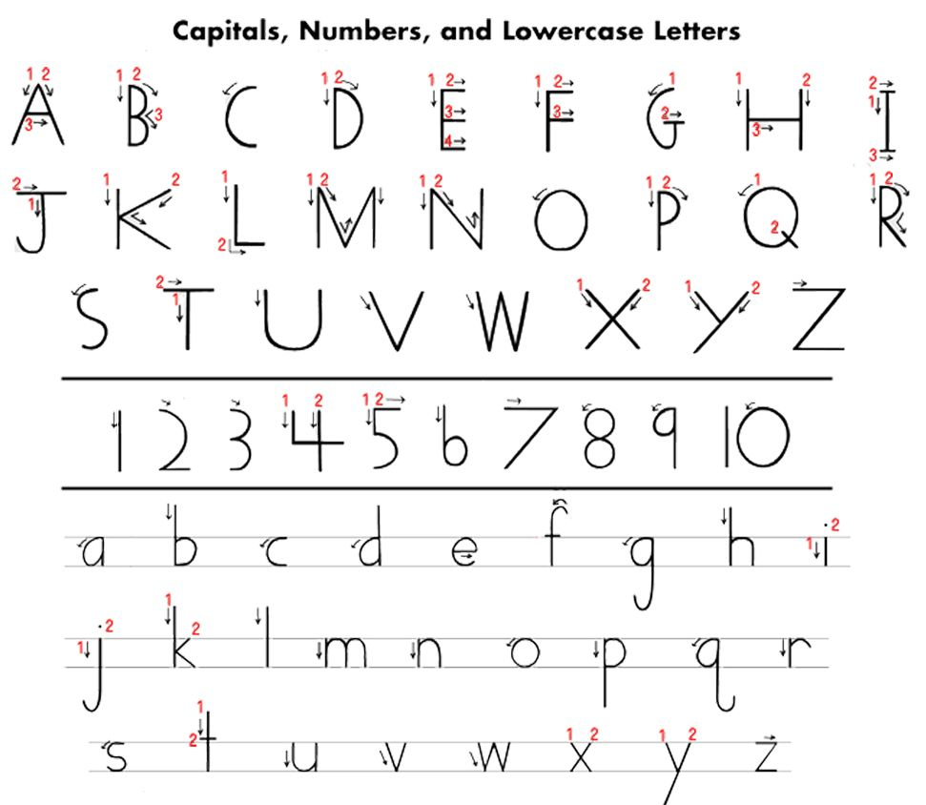

Slide 3
F

Slide 4
E

Slide 5
D

Slide 6
P

Slide 7
B

Slide 8
R

Slide 9
M

Slide 10
N

Slide 11
L

Slide 12
H

Slide 13
K

Slide 14
U

Slide 15
V

Slide 16
W

Slide 17
X

Slide 18
Y

Slide 19
Z

Slide 20
A

Slide 21
C

Slide 22
G

Slide 23
I

Slide 24
J

Slide 25
O

Slide 26
Q

Slide 27
S

Slide 28
T

